Slide 1

Jeevan.Data
Medical Assistant
Apoorva Bhardwaj
Mohd. Rehan
Rohit Kumar
Team:JavaTheHutt Hackfest
IIT(ISM) Dhanbad
Harsh Gupta
Himanshu Golchha

Slide 2
Overview
The main objective of our hack is to make the healthcare sector more organized and efficient.

Slide 3


Jeevan.Data plans to enable digitization of medical records thus making the healthcare sector more organized.
It aims to shift Indian patients to preventive healthcare using various AI-based algorithms which are able to predict various diseases in its preliminary stages.

Slide 4
Features
Accurate and quick diseases diagnosis using ML models
Using our webApp,a user can quickly check whether they are suffering from a particular disease just by uploading relevant data like X-ray scan,CT scan etc.
We currently have ML models for following diseases : 1.Covid -19
2.Pneumonia 3.Skin Cancer
4.Retinal Diseases(40 types)

Slide 5
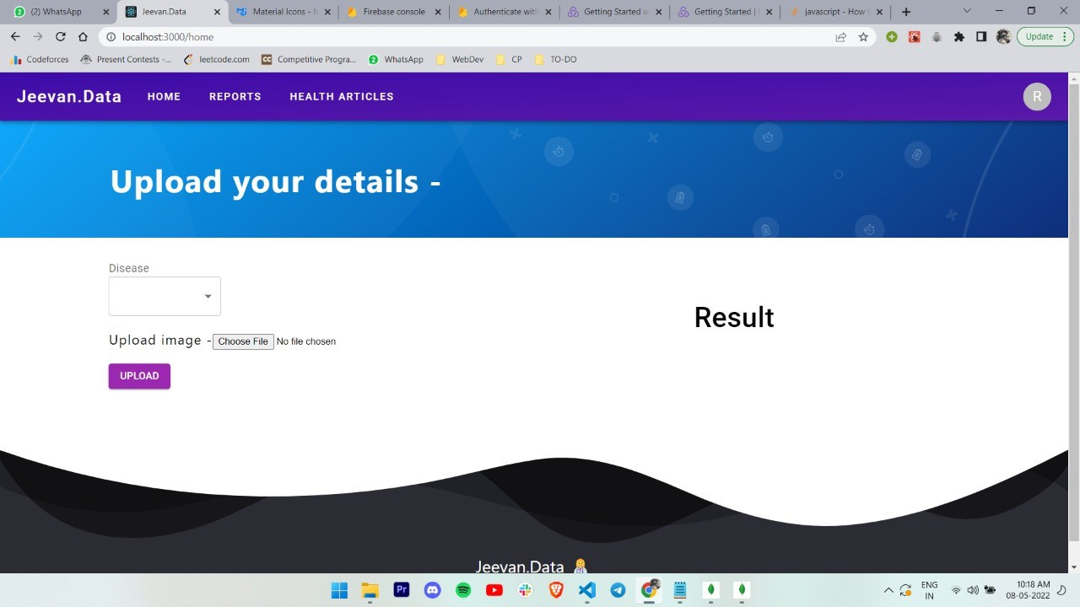

Slide 6
Features
Digitization of Medical records
We plan to lend a helping hand in the Digital India mission by enabling the digitization of medical records.
Every diagnosis that a user do,its report will be saved for future reference.Thus, a user can see the improvement/decline in their health over a period of time.
This will also prevent misplacement of medical records.

Slide 7
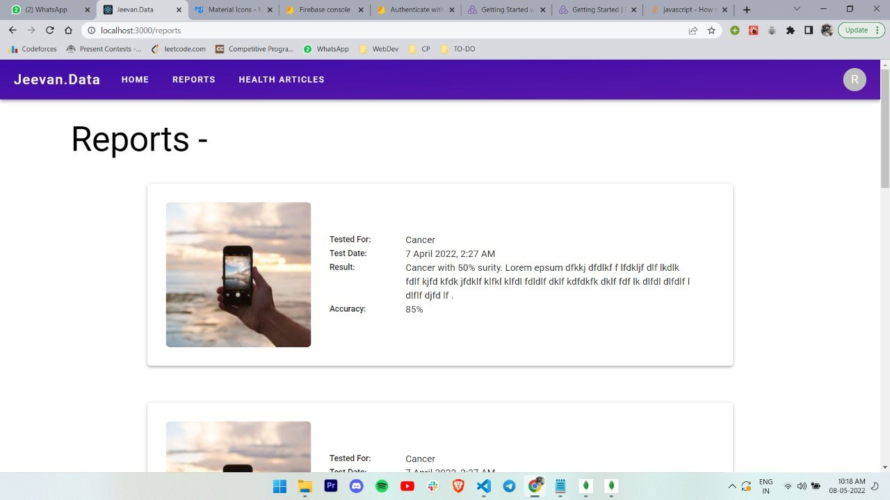

Slide 8
Features
Curated,latest health related articles:
There is a general lack of awareness among public regarding basic sanitation,healthcare.
So,latest articles related to health will be provided on our website to spread awareness about diseases and induce healthy habits among masses.

Slide 9
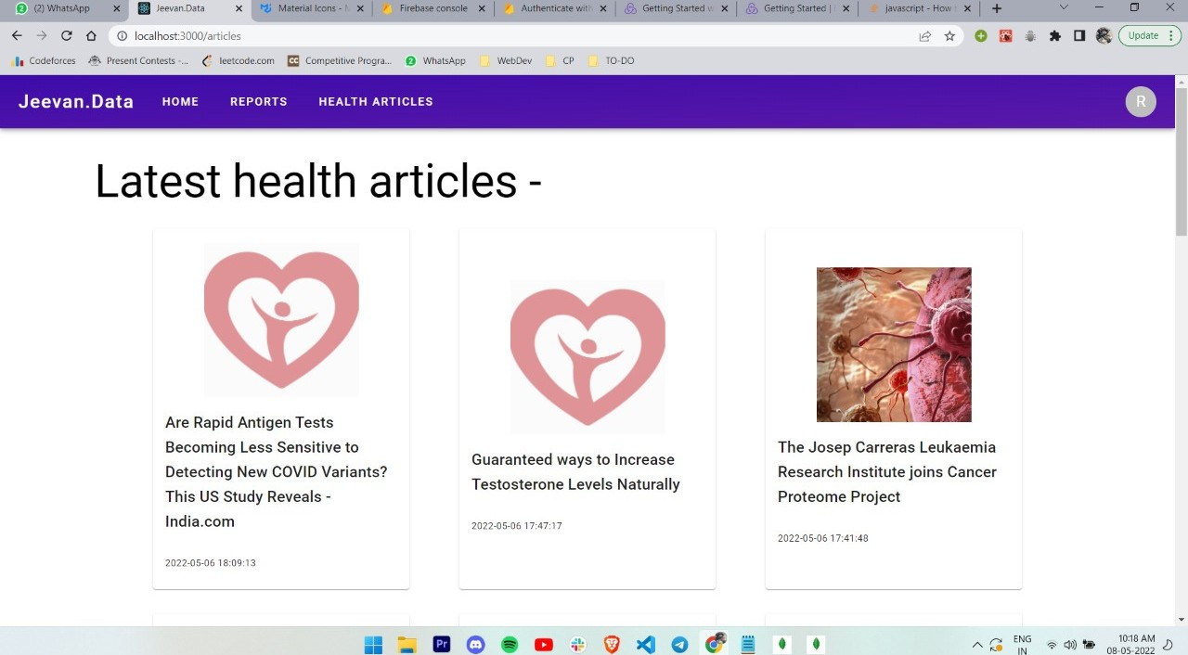

Slide 10
What do we plan to add/improve in future?
Inclusion of more diseases which can be diagnosed using ML models. Video call facility with doctors and experts
To make the project more visual/hearing impaired-friendly. Collaboration with the government to digitize all of the medical records present.

Slide 11
Repository Link-
https://github.com/shutupRohit/jeevan_data

Slide 12
Thannnkkk
youuu!!!

